Slide 1
DHCP
3. predavanje
Notes:
Presentation: 60 minutes
Lab: 60 minutes
After completing this module, students will be able to:
Describe Windows Server® 2012.
Describe the management tools available in Windows Server 2012.
Install Windows Server 2012.
Perform post‑installation configuration of Windows Server 2012.
Perform basic administrative tasks with Windows PowerShell®.
Required Materials
To teach this module, you need the Microsoft® Office PowerPoint® file 20410B_01.pptx.
Important: It is recommended that you use Office PowerPoint 2007 or a newer version to display the slides for this course. If you use PowerPoint Viewer or an earlier version of PowerPoint, all the features of the slides might not display correctly.
Preparation Tasks
To prepare for this module:
Read all of the materials for this module.
Practice performing the lab exercises.
Work through the Module Review and Takeaways section, and determine how you will use this section to reinforce student learning and promote knowledge transfer to on‑the‑job performance.
20410B
1: Deploying and Managing Windows Server 2012

Slide 2
Sadržaj
Instalacija DHCP uloge Konfiguriranje DHCP raspona Upravljanje i rješavanje problema Sigurnost i nadgledanje
Notes:
Briefly present module content.
Instruct students that DHCP is implemented in almost every company, and it is one of the foundational networking components in IT infrasture, so it is important for them to understand it.
20410B
6: Implementing Dynamic Host Configuration Protocol

Slide 3
Instalacija DHCP uloge
Prednosti korištenja DHCP-a Kako DHCP dodjeljuje IP adrese DHCP Lease Generation DHCP Lease Renewal DHCP Relay Agent DHCP autorizacija
Notes:
Briefly present the lesson content.
20410B
6: Implementing Dynamic Host Configuration Protocol

Slide 4
Prednosti korištenja DHCP-a
DHCP smanjuje administraciju korištenjem automatskih TCP/IP postavki
Automatska TCP/IP konfiguracija | Ručna TCP/IP konfiguracija
IP adrese se dodjeljuju automatski | IP adrese se unose ručno
Mala mogućnost pogrešne konfiguracije (zapravo, nepostojeća) | Veća mogućnost pogrešne konfiguracije
Klijentske postavke se automatski ažuriraju | Mrežni i komunikacijski problemi
Eliminiran je čest uzrok mrežnih grešaka | U slučaju čestih “premještanja” računala administracija postaje zamorna
Notes:
Define DHCP. Explain how DHCP reduces the complexity and amount of administrative work by using automatic IP configuration.
Explain the difference between manual and automatic IP configuration.
Provide examples of how DHCP reduces the complexity and amount of administrative work.
Instruct students that by using DHCP, correct configuration information is ensured—but only if DHCP is also configured correctly. If DHCP is misconfigured, then the clients will not receive the correct configuration from the DHCP server.
20410B
6: Implementing Dynamic Host Configuration Protocol

Slide 5



Kako DHCP dodjeljuje IP adrese
Ne-DHCP klijent: Statičke IP postavke
DHCP klijent2: IP postavke od DHCP servera
Lease Renewal
Lease Generation
DHCP Server
DHCP klijent1: IP postavke od DHCP servera
DHCP
Baza
IP Adresa 1: Dodijeljena DHCP klijentu 1
IP Adresa 2: Dodijeljena DHCP klijentu 2
IP Adresa 3: Slobodna za dodjeljivanje
Notes:
Ensure that students understand that the two methods for obtaining a lease are to request a new lease, or to renew an existing lease.
Explain to students that DHCP uses IP broadcasts to initiate communications. Therefore, DHCP servers are limited to communication within their IP subnet. This means that in many networks, there is a DHCP server for each IP subnet. When this is not feasible, either for cost or management reasons, you can use a DHCP relay agent. With the DHCP relay agent, the DHCP can broadcast packets for relay into another IP subnet across a router. This makes it possible to maintain a single DHCP server that services multiple IP subnets. DHCP packets can also be relayed into other subnets using a router that is compatible with
Request for Comment (RFC) 1542.
Instruct students that in a later topic you will discuss the DHCP relay agent in more detail.
20410B
6: Implementing Dynamic Host Configuration Protocol

Slide 6




DHCP Lease Generation
DHCP Server2
DHCP Server1
DHCP klijent
DHCP klijent šalje broadcastom DHCPDISCOVER paket
1
DHCP klijent šalje broadcastom DHCPDISCOVER paket
1
2
DHCP serveri šalju broadcastom DHCPOFFER paket
2
DHCP serveri šalju broadcastom DHCPOFFER paket
DHCP klijent šalje broadcastom DHCPREQUEST paket
3
DHCP klijent šalje broadcastom DHCPREQUEST paket
3
DHCP Server1 šalje broadcastom DHCPACK paket
4
DHCP Server1 šalje broadcastom DHCPACK paket
4
Notes:
Explain that DHCP uses a four-step process to lease IP addressing information to DHCP clients. Describe the DHCP lease-generation process by referring to the slide’s illustration.
It is important that students understand this process. Run through the demonstration as many times as necessary.
20410B
6: Implementing Dynamic Host Configuration Protocol

Slide 7
DHCP Lease Renewal
Postavke su “iznajmljene”
Nakon 50% lease vremena klijent pokušava obnoviti postavke
Nakon 87,5% lease vremena klijent pokušava još jednom obnoviti postavke
Nakon isteka vremena (100%) klijent broadcastom ponovno traži postavke
Notes:
DHCP Renewal occurs when 50% of lease duration has expired.
Describe the DHCP lease-renewal process by referring to the slide’s illustration.
References
MOC 2277C: Module 1
Microsoft TechNet: How DHCP Technology Works: http://go.microsoft.com/fwlink/?LinkID=112075&clcid=0x409

Slide 8
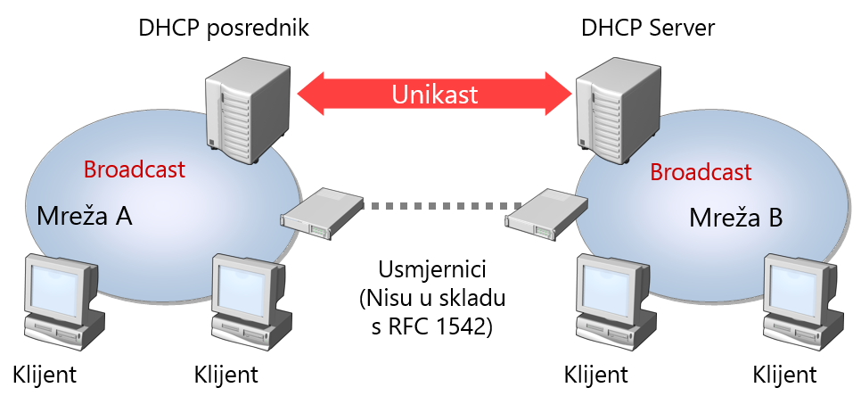
DHCP Relay Agent
Notes:
Inform students that today most routers and most enterprise switches (that can route) support RFC 1542.
20410B
6: Implementing Dynamic Host Configuration Protocol

Slide 9







DHCP autorizacija
DHCP autorizacija registrirathe DHCP Server service u AD-u
Ako DHCP Server1 pronađe svoju IP adresu na listi, servis se pokreće i odgovara klijentima
DHCP Server1 checks with the domain controller to obtain a list of authorized DHCP servers
DC
DHCP Server1
Autoriziran
AD DS
Servisira klijente
DHCP Server2
DHCP klijent
Neautoriziran
Ne servisira klijente
DHCP Server2 checks with the domain controller to obtain a list of authorized DHCP servers
DHCP klijent dobije IP adresu od autoriziranog DHCP Server1
Ako DHCP Server2 ne pronađe svoju IP adresu na listi, servis se ne pokreće i ne odgovara klijentima
Notes:
Students should know and understand the importance of DHCP authorization. An unauthorized DHCP server can cause problems in a network, and incorrectly configured clients can cause numerous issues.
Explain to students that when you install a DHCP role in a domain, an Enterprise Administrator must authorize it because several domains can exist in the same IP subnet.
Although it is not recommended, you can use a standalone server as a DHCP server if it is not on a subnet with any authorized DHCP servers. When a standalone DHCP server detects an authorized server on the same subnet, it automatically stops leasing IP addresses to DHCP clients.
It also is important to note that other network devices may run DHCP servers. These devices do not comply with the notion of being authorized, and therefore might cause issues in a networked environment.
20410B
6: Implementing Dynamic Host Configuration Protocol

Slide 10
Konfiguriranje DHCP raspona
Što su DHCP rasponi? Što je DHCP rezervacija? Što su DHCP opcije? Kako se DHCP opcije primjenjuju?
Notes:
Briefly introduce the lesson topics to students.
20410B
6: Implementing Dynamic Host Configuration Protocol

Slide 11
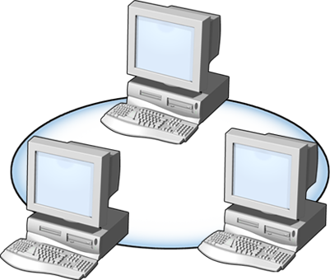

Što su DHCP rasponi?
DHCP raspon je skup IP adresa dostupnih za dodijeljivanje
DHCP Server
LAN B
LAN A
Raspon A
Raspon B
Svojstva raspona
Network ID Subnet mask | Trajanje Raspon IP adresa | Ime raspona Izuzete IP adrese
Notes:
Describe the purpose of a DHCP scope.
Explain that administrators must create a DHCP scope before leasing IP addresses to a client.
Instruct students that a scope may contain IP addresses that are NOT available for lease. These addresses are configured as an exclusion, which they will learn about in following topics.
Scope properties contain data about the scope, such as the scope range, the lease duration, Domain Name System (DNS) update settings, Network Address Protection (NAP) configuration, and DHCP/BOOTP configuration options.
Describe IPv4 or IPv6 scope capabilities.
Explain that you can create scopes by using the New Scope Wizard, or by using the Netsh command-line tool. Also, mention that this wizard and this tool will be discussed more later in this module.
20410B
6: Implementing Dynamic Host Configuration Protocol

Slide 12



Što je DHCP rezervacija?
DHCP rezervacija je kada se određena IP adresa unutar raspona uvije dodjeljuje točno određenom DHCP klijentu
DHCP Server
FPS1
Subnet A
Subnet B
Klijent 1
Klijent 2
IP Address1: Dodijeljena klijentu 1
IP Address2: Dodijeljena klijentu 2
IP Address3: Rezervirana za FPS1
Notes:
Explain what a DHCP reservation is.
Explain why and when you would use a DHCP reservation. For example, if you intend to have network devices—such as network printers—it often is desirable to provide them with a fixed address. This ensures that IP addresses in a predefined scope are not assigned inadvertently to another device. This also ensures that should a scope be depleted of addresses, the devices with reservations will be guaranteed to have an IP address.
To configure a reservation, you must know the media access control (MAC) or physical address of the device. This is how the DHCP server knows that the device should have a reservation.
20410B
6: Implementing Dynamic Host Configuration Protocol

Slide 13
Što su DHCP opcije?
DHCP su vrijednosti najčešćih konfiguracijskih postavki koje se odnose na DHCP server, raspon IP adresa, rezervirane IP adrese ili na klase
Najčešće opcije su:
Router (Zadani pristupnik)
DNS ime
DNS Servers
WINS Servers
Notes:
Explain the purpose of DHCP options.
Mention the DHCP options that you use in Windows®-based operating systems deployment, that utilize Preboot eXecution Environment (PXE), which requires a DHCP server.
20410B
6: Implementing Dynamic Host Configuration Protocol

Slide 14
Kako se DHCP opcije primjenjuju?
DHCP opcije možemo primijeniti na različitim nivoima:
Server
Scope
Class
Reserved client
Notes:
Explain how DHCP applies options to client computers when multiple options are configured at the server, scope, class, and reserved-client level. Ensure that students understand that DHCP applies options to client computers in a specific order:
Server level
Scope level
Class level
Reserved-client level
It is also important that students understand these three points:
Scope options override server options.
Class options override both scope and server options.
Reserved client options apply to devices that have a DHCP reservation.
20410B
6: Implementing Dynamic Host Configuration Protocol

Slide 15
Upravljanje i rješavanje problema
Što je DHCP baza? Backing Up i Restore DHCP baze Sravnjivanje DHCP baze Premještanje DHCP baze
Visoka dostupnost DHCP Što je DHCP Failover?
Rješavanje problema s DHCP-om
Notes:
Briefly present the lesson content.
20410B
6: Implementing Dynamic Host Configuration Protocol

Slide 16
Što je DHCP baza?
DHCP baza sadrži konfiguracijske postavke kao što su:
Scopes - rasponi
Reservations - rezervacije
Address leases – dodijeljene adrese
Windows Server 2008 pohranjuje bazu u mapi %Systemroot%\System32\Dhcp
Datoteke koje sadrže bazu:
Dhcp.mdb
Tmp.edb
J50.log and J50*.log
Res*.log
J50.chk
Notes:
Describe the DHCP database.
Emphasize that the J50.log file, J50#####.log file, Dhcp.mdb file, and Dhcp.tmp file should not be removed or altered.
Describe compacting the DHCP database.
Ensure that students understand that DHCP databases do not recover space automatically when records are erased. Thus, the database is compacted periodically. If database use increases, it may be necessary to compact it manually. Starting with the Microsoft Windows NT® Server 4.0 operating system, dynamic database compaction occurs on DHCP servers as an automatic background process during idle time or after a database update.
20410B
6: Implementing Dynamic Host Configuration Protocol

Slide 17






Backing Up i Restore DHCP baze
DHCP Server
Vanjska lokacija
Restore
DHCP
Back up
Restore
DHCP
Back up
Ukoliko prilikom paljenja servisa nije moguće pokrenuti bazu DHCP radi automatski restore zadnjeg backupa baze s lokalnog diska
Administrator kopira ili premjesti backup DHCP baze na vanjsku lokaciju
DHCP automatski kreira backup baze na lokalnom disku
U slučaju prestanka rada servera administrator može napraviti restore podataka s vanjske lokacije
Notes:
Describe how you back up and restore the DHCP database.
Automatic Backup (Synchronous Backup)
Occurs every 60 minutes.
Best practice: Ensure that you keep an offsite backup of the database.
Best practice: Make sure that your automatic backup is to a different volume than that on which your DHCP server is running.
Manual Backup (Asynchronous Backup)
Requires administrative-level permissions. Can also be a member of the DHCP administrators group.
Show the students where option for manual backup is in the console.
What is backed up
All scopes
Reservations
Leases
All options, including server options, scope options, reservation options, and class options
All registry keys and other configuration settings that are set in DHCP server properties. These settings are stored in the following registry subkey:
HKEY_LOCAL_MACHINE\SYSTEM\CurrentControlSet\Services\DHCPServer\Parameters
To back up this subkey, open Registry Editor and then save the specified key to a text file.
Backup Security
Best Practice: Backups that are stored on another volume should grant permissions only to the administrator and the DHCP administrator groups.
Restore Process
Requires administrative-level permissions. Can also be a member of the DHCP administrator group.
Note: Mention that performing a system state backup of a server that is hosting the DHCP server role results in a backup of the DHCP database and configuration.
20410B
6: Implementing Dynamic Host Configuration Protocol

Slide 18


Sravnjivanje DHCP baze
DHCP
Database
Detaljne informacije o iznajmljenim IP adresama
Uspoređuje i sravnjuje podatke
Registry
Sumarne informacije o iznajmljenim IP adresama
DHCP Server
Primjer
Registry | DHCP baza | Nakon sravnjivanja
Klijent ima IP adresu 192.168.1.34 | IP adresa 192.168.1.34 je dostupna | U DHCP bazu se upisuje informacija o iznajmljenoj adresi
Notes:
Explain how you reconcile a DHCP database.
20410B
6: Implementing Dynamic Host Configuration Protocol

Slide 19
Premještanje DHCP baze
DHCP
Database
Backup
Media
DHCP
Database
Stari DHCP Server
Novi DHCP Server
Notes:
You can move a DHCP database from one server to another by using the normal backup and restore procedure.
Steps for moving a DHCP database:
Back up the DHCP database on the old server.
Stop the old DHCP server.
Copy the DHCP database to the new server and, if necessary, install the DHCP server role.
Restore the database.
Start the DHCP Server service.
20410B
6: Implementing Dynamic Host Configuration Protocol

Slide 20
Visoka dostupnost DHCP
Tri metode za DHCP visoku dostupnost u Windows Server 2012:
DHCP u Failover Cluster
Split-scope DHCP
DHCP Failover
Notes:
Introduce the methods for providing high availability for DHCP, emphasizing the drawbacks of Failover Clustering and split-scope DHCP implementation. Introduce DHCP Failover, but do not go into too much detail as this is covered in the next topic.
10970A
1: Implementing IPv4 Services

Slide 21
DHCP Failover?
Failover odnos mora imati unikatno ime
MCLT određuje kada DHCP partner preuzima vlasništvo nad rasponom IP adresa
Failover dva načina rada:
Hot Standby mode
Load Sharing mode
Auto State Switchover Interval određuje kada se smarta da partner više nije dostupan
Message authentication može potvrditi ispravnost poruka
Vatrozid pravila se automatski konfiguriraju
Notes:
Explain how DHCP failover enables redundant DHCP infrastructure in case of failure. Explain how DHCP failover is configured, and the important parameters to consider while configuring.
10970A
1: Implementing IPv4 Services

Slide 22
Rješavanje problema s DHCP-om
Najčešći alati za rješavanje problema:
Windows PowerShell
Ipconfig
DHCP statistika
DHCP audit logovi
Notes:
Review the common tools, components, and methods for troubleshooting DHCP in Windows Server 2012.
10970A
1: Implementing IPv4 Services

Slide 23
Sigurnost i nadgledanje
Onemogućavanje da neautorizirani klijenti dobiju IP adresu Onemogućavanje ne autoriziranih ne-Microsoft DHCP servera da dodjeljuju IP adrese Delegiranje DHCP administracije DHCP Statistics DHCP Audit Logovi Najčešći DHCP problemi
Notes:
Briefly present the lesson content.
20410B
6: Implementing Dynamic Host Configuration Protocol

Slide 24
Onemogućavanje da neautorizirani klijenti dobiju IP adresu
Neautorizirani korisnici ne bi smjeli imati pristup fizičkoj ili bežičnoj mreži
Uključiti audit logove za sve DHCP poslužitelje na mreži
Provjeravati i nadgledati audit log datoteke
Koristiti 802.1X LAN preklopnike ili bežične pristupne točke
Konfigurirati NAP da bi provjerili zdravstvenu ispravnost računala koja se spajaju u mrežu
Notes:
Discuss the guidelines for preventing an unauthorized computer from obtaining a lease.
Emphasize that the only way to prevent unauthorized access completely using only DHCP is to disallow network access. However, this is not feasible. Therefore, the next best actions are to limit the possibility of an unauthorized user plugging into an empty network jack, and to implement security on a wireless network.
Use NAP to validate a client computer’s health. NAP can determine if the computer is running both an up‑to‑date antivirus program and the latest Windows operating system updates. If the computer is not compliant with the NAP policy, it can be denied network access or it can be relegated to a remediation network where it may obtain the necessary updates to become compliant.
You also can use NAP to restrict access to a network based on whether the user is authorized for network access.
Some organizations lock down the network ports based on MAC address. Each MAC address is restricted to a specific port. If a different MAC address attempts to communicate on that port, the port will shut down.
20410B
6: Implementing Dynamic Host Configuration Protocol

Slide 25






Onemogućavanje ne autoriziranih ne-Microsoft DHCP servera da dodjeljuju IP adrese
DHCP klijenti
Ne-autorizirani DHCP poslužitelj
DHCP klijenti
Naš DHCP poslužitelj
Da bi onemogućili ne-autorizirani DHCP poslužitelj da dijeli klijentima IP adrese moramo ga locirati i fizički onemogućiti rad poslužitelja ili DHCP servisa
Notes:
Mention to students that users must disable DHCP services from other devices, such as routers or non‑Microsoft tools.
If users complain of network access problems, check the IP settings that the DHCP server is providing by using the ipconfig/all command.
If the DHCP server result is not correct, investigating the IP address in question should identify the problem.
The only way to restrict unauthorized DHCP servers is to find their source IP, and then to remove them from the network.
20410B
6: Implementing Dynamic Host Configuration Protocol

Slide 26
Delegiranje DHCP administracije
Da bi delegirali administraciju DHCP servisa:
Ograničimo članstvo DHCP Administrators grupe
Dodajmo korisnike u DHCP Users grupu ako samo trebaju čitati sadržaj DHCP konzole
Grupa | Dozvole
DHCP Administrators | Može čitati i modificirati podatke pomoću DHCP konzole
DHCP Users | Može čitati podatke pomoću DHCP konzole
Notes:
20410B
6: Implementing Dynamic Host Configuration Protocol

Slide 27
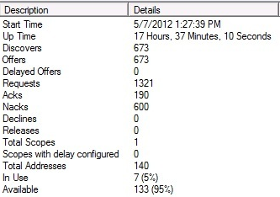
DHCP Statistika
DHCP statistika se prikuplja i prikazuje na razini raspona IP adresa ili na razini cijelog poslužitelja
DHCP poslužitelj
Notes:
Explain that DHCP statistics provide a general view of DHCP activity and usage.
Point out to students that you can configure the refresh rate for the statistics in the General tab of server’s Properties dialog box.
Show students the statistics panel in the DHCP Server.
For the DHCP server statistics section
Provide an overview of DHCP server usage. Point out to students that they can use this data to understand the DHCP server’s state quickly.
For the DHCP scope statistics section
Provide basic data about the leases in the DHCP scope.
20410B
6: Implementing Dynamic Host Configuration Protocol

Slide 28
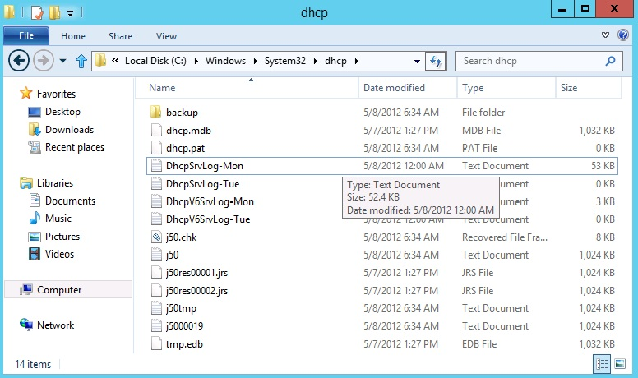
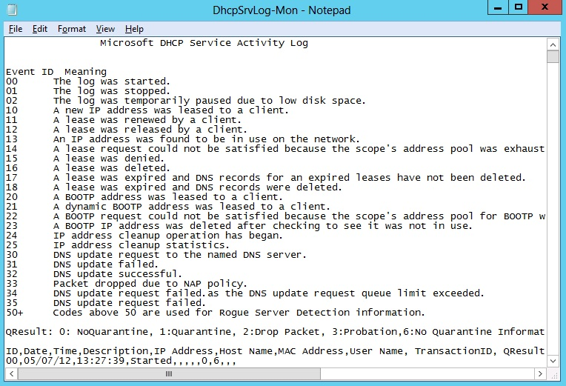
DHCP Audit Logovi
Notes:
Describe the purpose of the DHCP audit log.
Explain that the DHCP audit log file is stored in systemroot\system32\dhcp, and that the name of the audit log file is based on the weekday it was created. For example, if the day of the week is Monday, then the file name is DhcpSrvLog‑Mon.log.
20410B
6: Implementing Dynamic Host Configuration Protocol

Slide 29
Najčešći DHCP problemi
Konflikti IP adresa
Nemogućnost dobivanja IP adrese od DHCP poslužitelja
Adresa dodijeljena iz krivog raspona
DHCP baza je korumpirana ili oštećena
DHCP server je ostao bez slobodnih IP adresa
Notes:
Discuss common issues that can occur when you do not configure DHCP properly.
For each of the issues, ask the students:
What tests, tools, and procedures would they use to troubleshoot the issue?
What is the cause of the issue?
What would they consider the solution?
Each student should write in the empty space of the table the possible cause and their opinion about the solution.
Some suggested answers to aid the discussion:
Address conflicts:
Check for manually configured computers with a conflicting address.
Verify that scopes do not contain overlapping addresses.
Inform students that a DHCP server can be configured to ping an IP address before it leases it, which helps prevent conflicts.)
Failure to obtain a DHCP address:
Verify that the DHCP server is online.
Verify connectivity to the subnet containing the DHCP server.
Verify that there are sufficient addresses in the address pool.
Address obtained from incorrect scope.
Check other clients in the subnet for their configuration.
DHCP database suffers data corruption or loss.
Restore or recreate the DHCP database.
DHCP server exhausts its IP address pool.
Reduce the lease duration.
Consider redesigning the IP address pools.
20410B
6: Implementing Dynamic Host Configuration Protocol

Slide 30
?

